Slide 1



CAPSTONE PROJECT 4 ML using Python
Kimberly Tan
Aug 2022

Slide 2
Content
1. Introduction & Data Collection
2. Objectives
3. Exploratory Data Analysis
4. Data Cleaning & Preparation
5. Data Analysis using Visualizations
6. Creating Machine Learning Models and Evaluating Performance
7. Conclusion

Slide 3

Introduction
Marketing expenditures in the banking industry is very high, meaning it’s essential for banks to optimize their marketing strategies.
Understanding your clients’ demographics, behaviours and needs leads to a more effective marketing campaigns, customer-fit products and greater customer satisfaction.
Data Collection
Industry: Finance - Portuguese banking institution
Domain: Marketing – Telemarketing campaigns
Data Source: https://archive-beta.ics.uci.edu/ml/datasets/bank+marketing
Associated Tasks: Classification
Reference: https://www.kaggle.com/code/janiobachmann/bank-marketing-campaign-opening-a-term-deposit/notebook
3
Notes:
This dataset is about the direct phone call marketing campaigns, which aim to promote term deposits among existing customers, by a Portuguese banking institution from May 2008 to November 2010. It is publicly available in the UCI Machine learning Repository, which can be retrieved from http://archive.ics.uci.edu/ml/datasets/Bank+Marketing#.

Slide 4


How?
GOALS
(1) To understand the current customer base, predict customers' response to its telemarketing campaign and establish a target customer segment for future marketing plans.
Increase the effectiveness of bank’s telemarketing campaign
identify which Types of customers are more likely to make a term deposits
(2) Analyse customers’ features, such as demographics & transaction history to predict customer saving behaviours.
4

Slide 5
Data Cleaning & Transformation
5

Slide 6
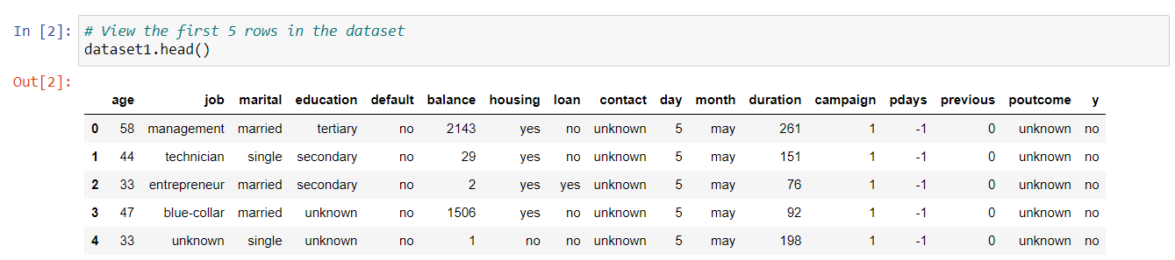
Get a feel of the data
6
Notes:
The dataset records 16 input variables of the customer, such as age, job, housing and personal loan status, account balance, and the number of contacts.
There is a single binary output variable “Y” that denotes “yes” or “no” to whether customer subscript to a deposit.

Slide 7
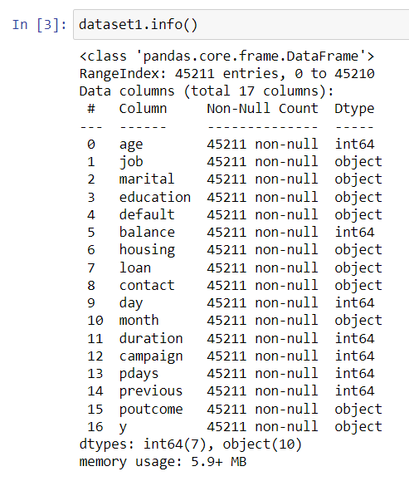
Get a feel of the data
7
Notes:
We have both qualitative and quantitative attributes.

Slide 8
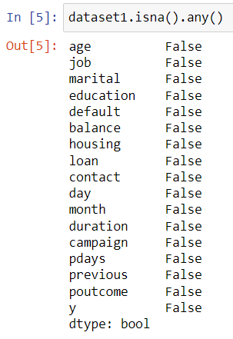
Check for Null Values
8

Slide 9
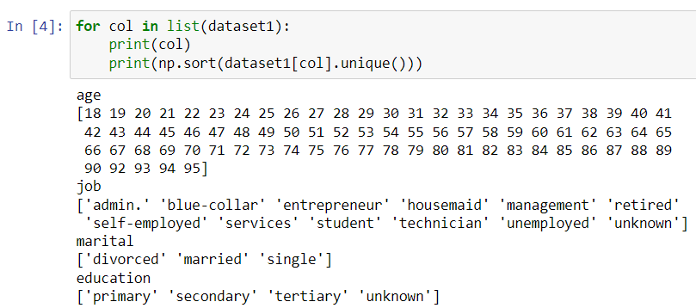
Unique Values
9

Slide 10
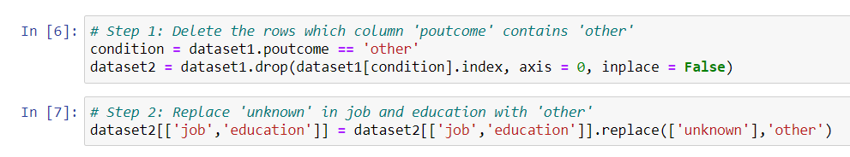
Remove ambiguous values like “Unknown” & “Other” the dataset.
10

Slide 11
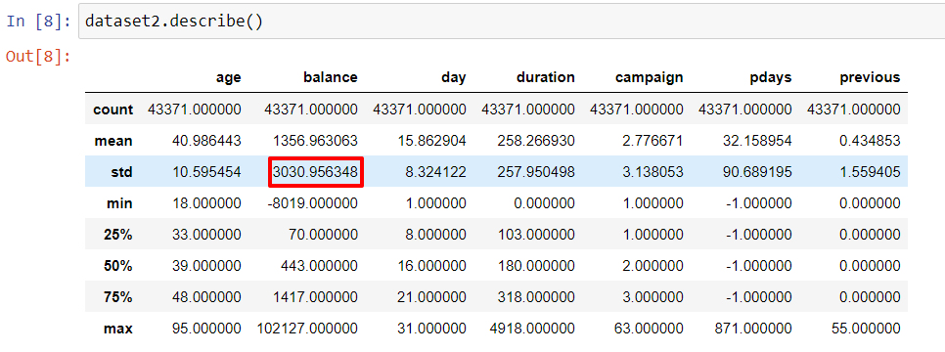
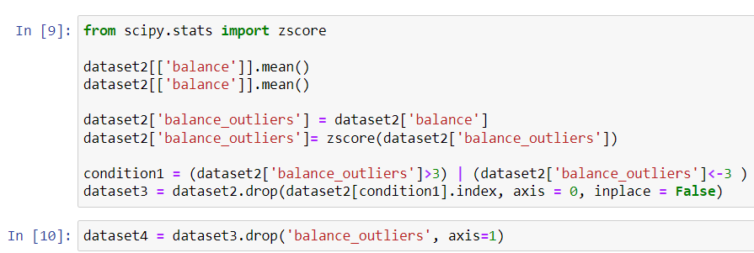
Remove outliers from balance column.
11
Notes:
Outliers in the column “balance” are dropped. Outliers are defined as the values which are more than three standard deviations away from the mean.

Slide 12
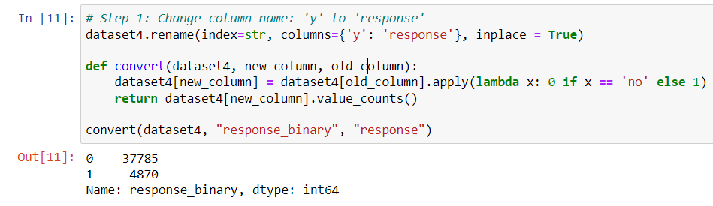
Creating and Transforming Data
12

Slide 13
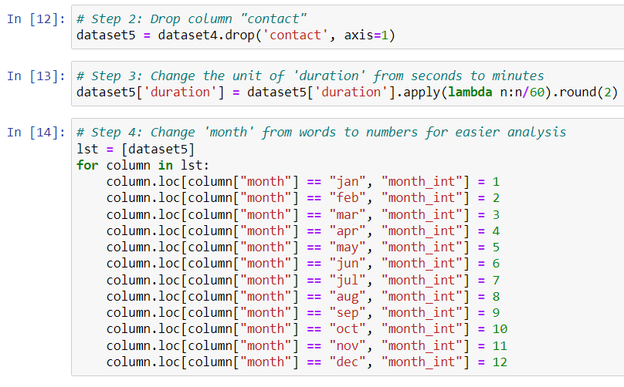
Creating and Transforming Data
13

Slide 14
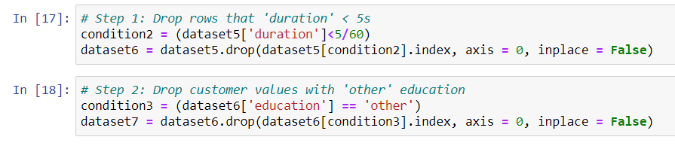
Data Filtering
14

Slide 15
Exploratory Data Analysis
15
Notes:
Analysis of each variable distribution and it’s relationships.

Slide 16
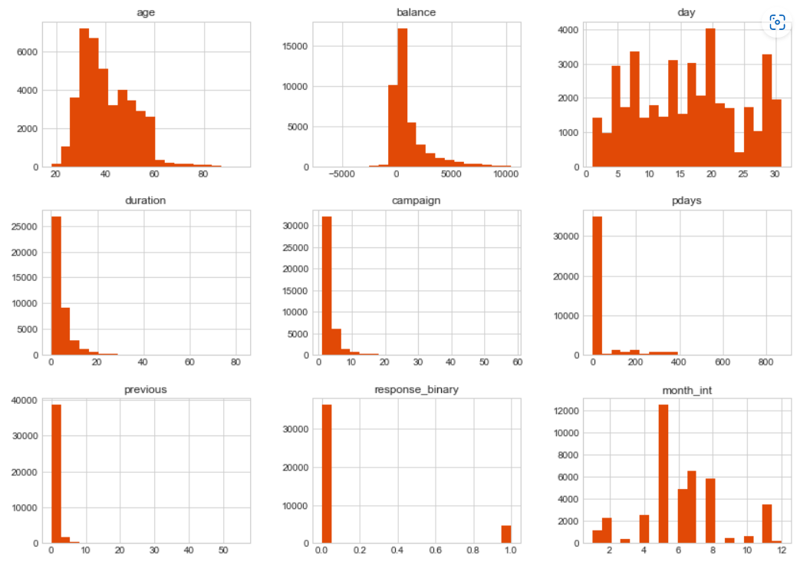
Overall Distribution of Variables
16

Slide 17
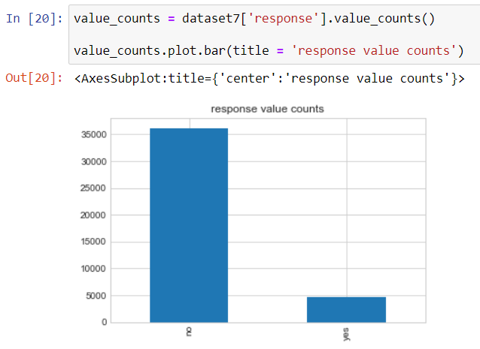
Response Counts
17

Slide 18
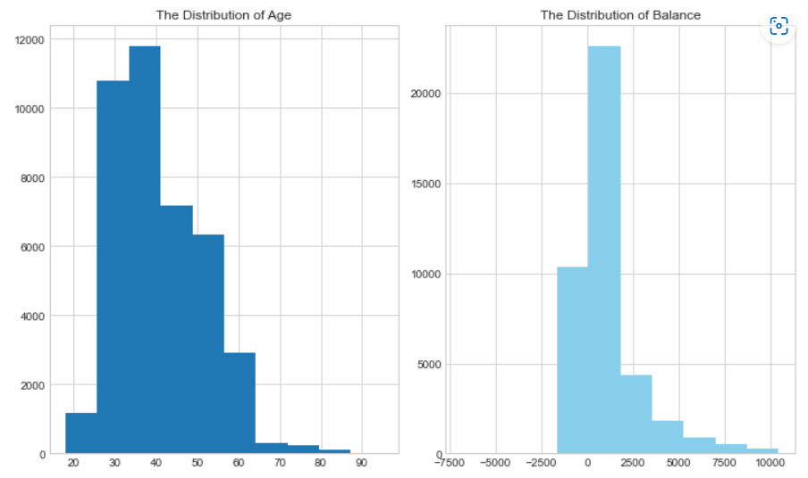
Visualization of “age” and “balance” distribution
Age: Extensive age range, from 18 to 95 years old. Majority 30s and 40s. The distribution of fairly normal with a small standard deviation.
Balance: Range of balance is still massive, from a minimum of -6847 to a maximum of 10,443 euros. The distribution of balance has a huge standard deviation relative to its mean, indicates large records in customers' balance levels.
18

Slide 19
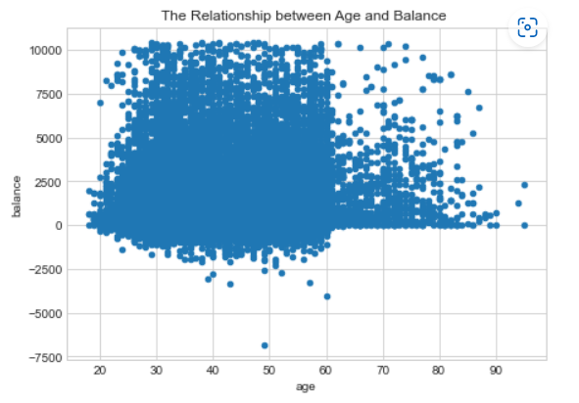
Visualization of relationship between “age” and “balance”
Over the age of 60, clients tend to have a significantly lower balance, mostly under 5,000 euros. This is since most people retire after 60 and no longer have a reliable income source.
19

Slide 20
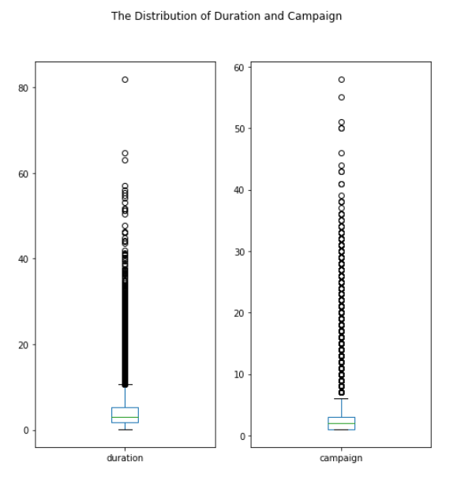
Visualization of “duration” & “campaign” distribution
Duration: contact of median of 3 minutes, with an interquartile range of 1.73 minutes to 5.3 minutes. The left-skewed boxplot indicates that most calls are relatively short. Outliers are also seen ranging from 10 minutes to 40 minutes
Campaign: 50% of the customers have been contacted by the bank for the second time, 25% was first introduced to the term deposit. Most customers have been reached by the bank for one to three times.
20

Slide 21
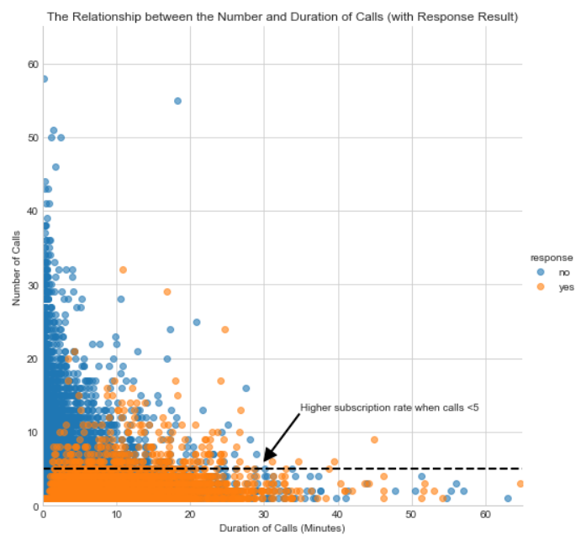
Visualization of relationship between “duration” & “campaign” with “response” result
Comparing the “no” customers”, “yes” customers were contacted by fewer times and had longer call duration.
More importantly, after 5 campaign calls, clients are more likely to reject the term deposit unless the duration is high.
Most “yes” clients were approached by less than 10 times.
21

Slide 22
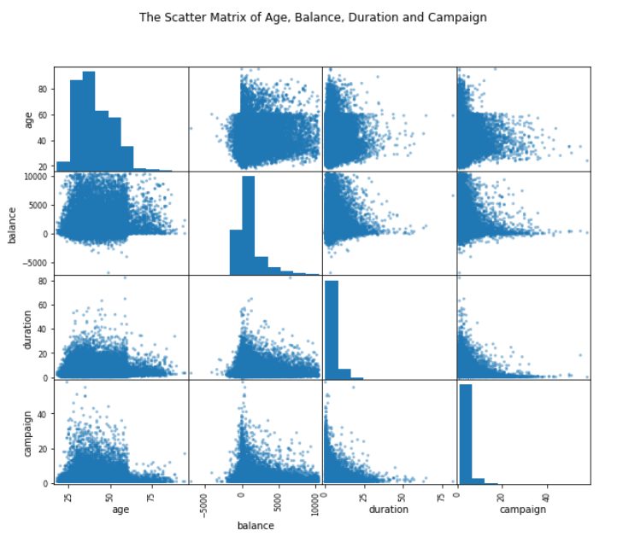
Scatter Matrix
Did not reveal any clear relationship among age, balance, duration and campaign.
22

Slide 23
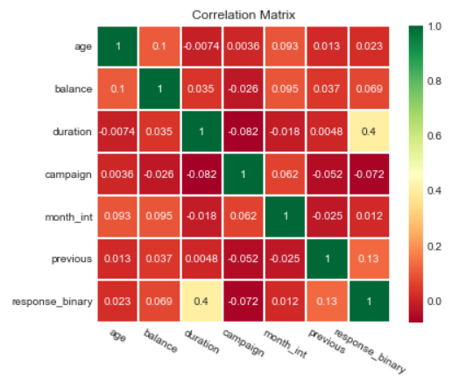
Correlation Matrix
“campaign outcome” has a strong correlation with “duration”, a moderate correlation with “previous contacts”, and mild correlations between “balance” and “month of contact”.
23

Slide 24
Data Visualization
24
Notes:
Further analysis of each customer characteristic can be carried out to investigate its influence on the subscription rate.

Slide 25
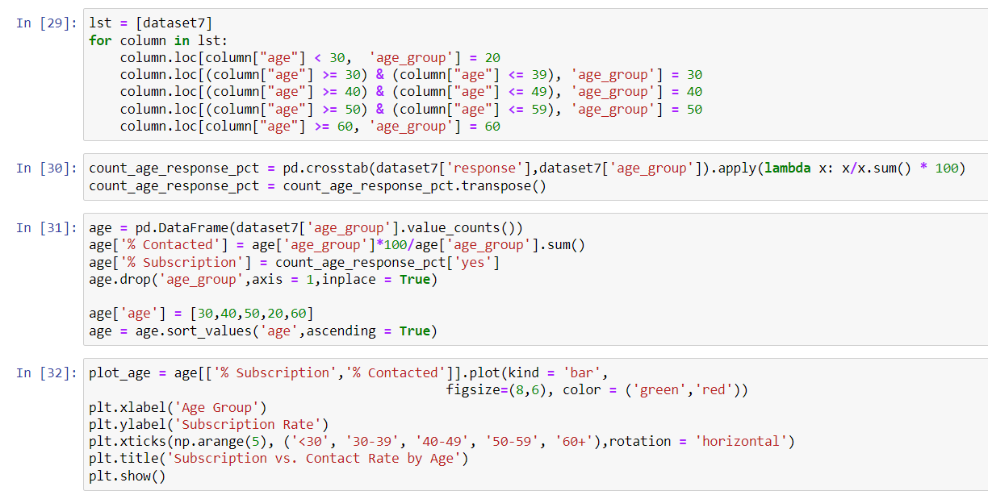
Visualization of “deposit subscription” and “contact” rate by “age”
25

Slide 26
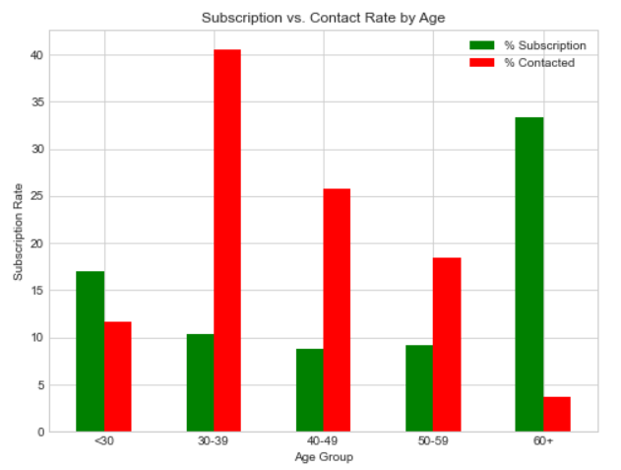
Visualization of “deposit subscription” and “contact” rate by “age”
Insights: target the youngest and the oldest instead of the middle-aged
26
Notes:
Insights: target the youngest and the oldest instead of the middle-aged
Green vertical bars indicate that clients with a age of 60+ have the highest subscription rate. About 17% of the subscriptions came from the clients aged between 18 to 29. More than 50% of the subscriptions are contributed by the youngest and the eldest clients.
It is not surprising to see such a pattern because the main investment objective of older people is saving for retirement while the middle-aged group tend to be more aggressive with a main objective of generating high investment income. Term deposits, as the least risky investment tool, are more preferable to the eldest.
The youngest may not have enough money or professional knowledge to engage in sophisticated investments, such as stocks and mutual funds. Term deposits provide liquidity and generate interest incomes that are higher than the regular saving account, so term deposits are ideal investments for students.
However, red vertical bars show that the bank focused its marketing efforts on the middle-aged group, which returned lower subscription rates than the younger and older groups. This may be misconception that middle-age group have more earning power.

Slide 27
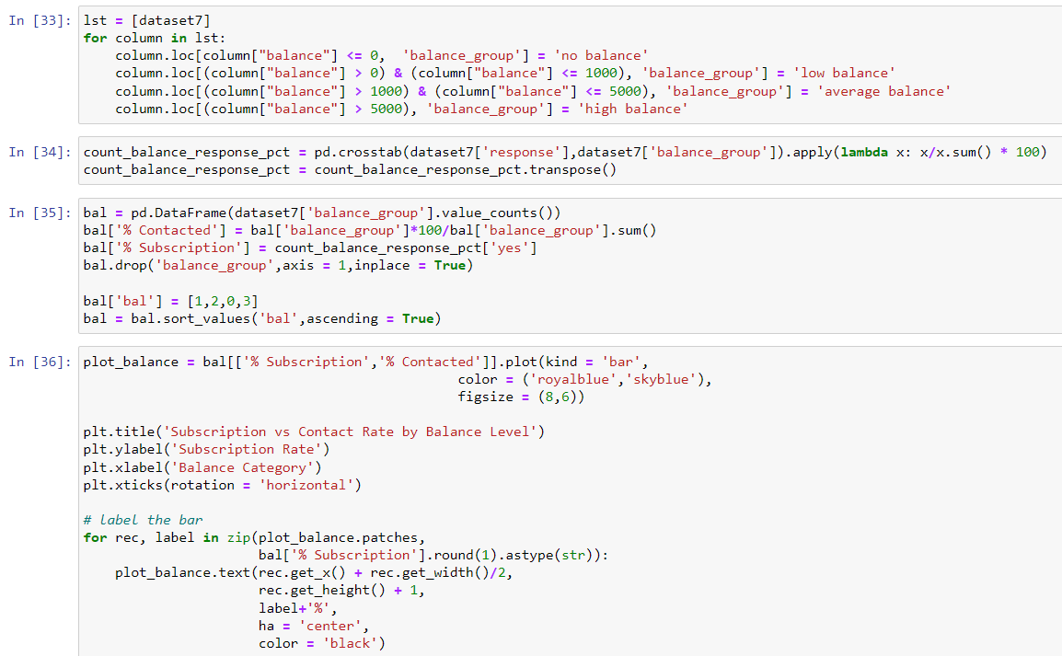
Visualization of “deposit subscription” rate by “balance”
27
Notes:
Insights: target the youngest and the oldest instead of the middle-aged
Green vertical bars indicate that clients with a age of 60+ have the highest subscription rate. About 17% of the subscriptions came from the clients aged between 18 to 29. More than 50% of the subscriptions are contributed by the youngest and the eldest clients.
It is not surprising to see such a pattern because the main investment objective of older people is saving for retirement while the middle-aged group tend to be more aggressive with a main objective of generating high investment income. Term deposits, as the least risky investment tool, are more preferable to the eldest.
The youngest may not have enough money or professional knowledge to engage in sophisticated investments, such as stocks and mutual funds. Term deposits provide liquidity and generate interest incomes that are higher than the regular saving account, so term deposits are ideal investments for students.
However, red vertical bars show that the bank focused its marketing efforts on the middle-aged group, which returned lower subscription rates than the younger and older groups. This may be misconception that middle-age group have more earning power.

Slide 28
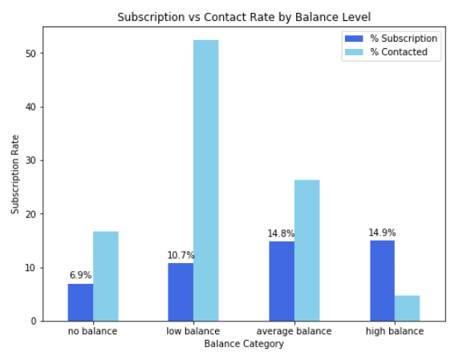
Visualization of “deposit subscription” rate by “balance”
Insights: target clients with average or high balance
28
Notes:
Unsurprisingly, this bar chart indicates a positive correlation between clients’ balance levels and subscription rate. Clients with negative balances only returned a subscription rate of 6.9% while clients with average or high balances had significantly higher subscription rates, nearly 15%.
However, in this campaign, more than 50% of clients contacted only have a low balance level. In the future, the bank should shift its marketing focus to high-balance customers to secure more term deposits.

Slide 29
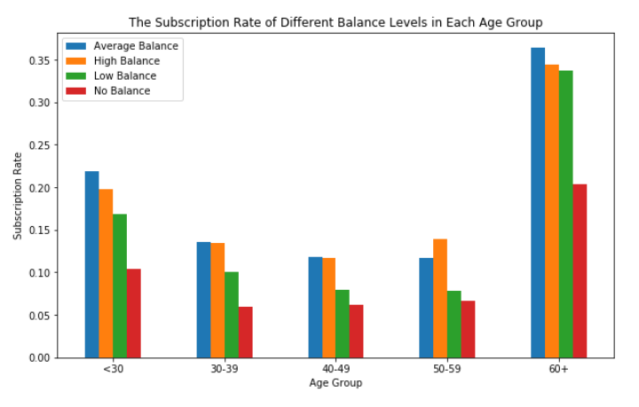
Visualization of “deposit subscription” rate by “age” and “balance”
Insights: target older clients with high balance levels
29
Notes:
The graph tells the same story regarding the subscription rate for different age groups: the willingness to subscribe is exceptionally high for people aged above 60 and younger people aged below 30 also have a distinguishable higher subscription rate than those of other age groups.
Furthermore, the effect of balance levels on subscription decision is applicable to each individual age group: every age group shares a common trend that the percentage of subscription increases with balance.
In sum, the bank should prioritize its telemarketing to clients who are above 60 years old and have positive balances, because they have the highest acceptance rate of about 35%. The next group the bank should focus on is young clients with positive balances, who showed high subscription rates between 15% and 20%.

Slide 30
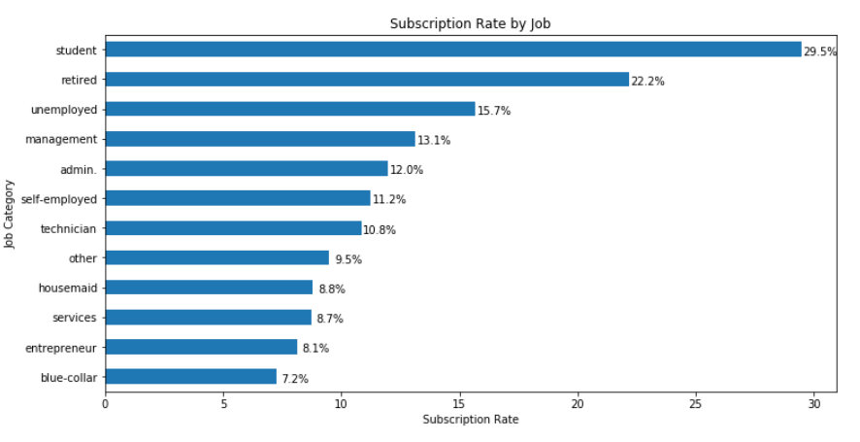
Visualization of “deposit subscription” rate by “job”
Insights: target students and retired clients
30
Notes:
students and retired clients account for more than 50% of subscription, which is consistent with the previous finding of higher subscription rates among the younger and older.

Slide 31
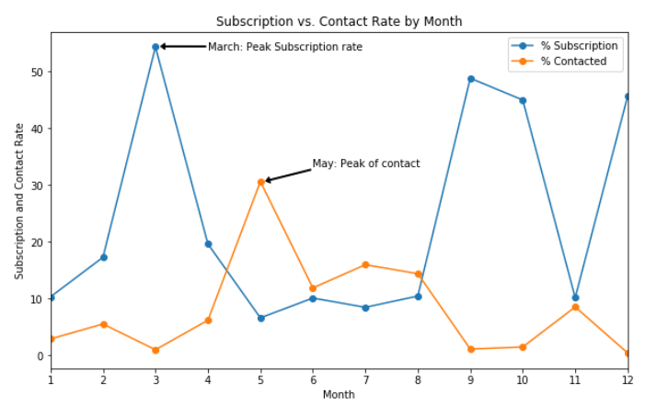
Visualization of “deposit subscription” and “contact rate by month
Insights: initiate the telemarketing campaign in fall or spring
31
Notes:
The bank contacted most clients between May and August. The highest contact rate is around 30%, which happened in May, while the contact rate is closer to 0 in March, September, October, and December.
However, the subscription rate showed a different trend. The highest subscription rate occurred in March, which is over 50%, and all subscription rates in September, October, and December are over 40%.
Clearly, these two lines move in different directions which strongly indicates the inappropriate timing of the bank’s marketing campaign. To improve the marketing campaign, the bank should consider initiating the telemarketing campaign in fall and spring when the subscription rate tends to be higher.

Slide 32
Machine Learning: Classification
32
Notes:
Classification algorithms will be employed. By analyzing customer statistics, a classification model will be built to classify all clients into two groups: "yes" to term deposits and "no" to term deposits.

Slide 33
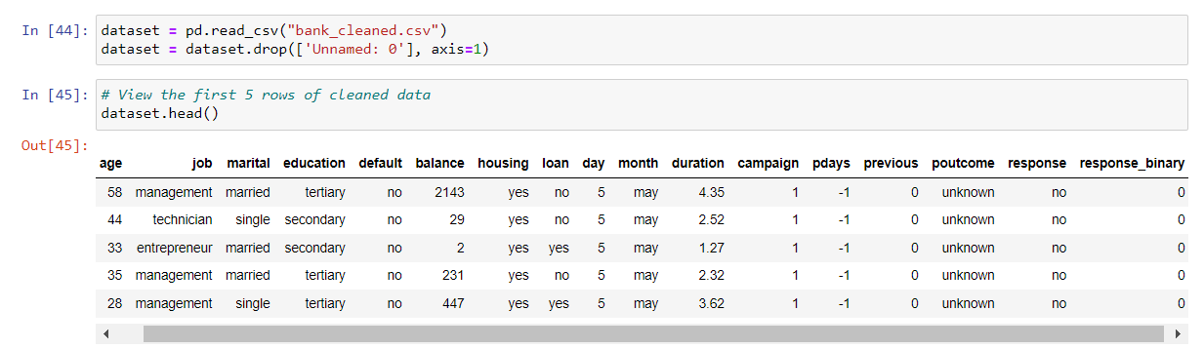
Load the cleaned dataset
33

Slide 34
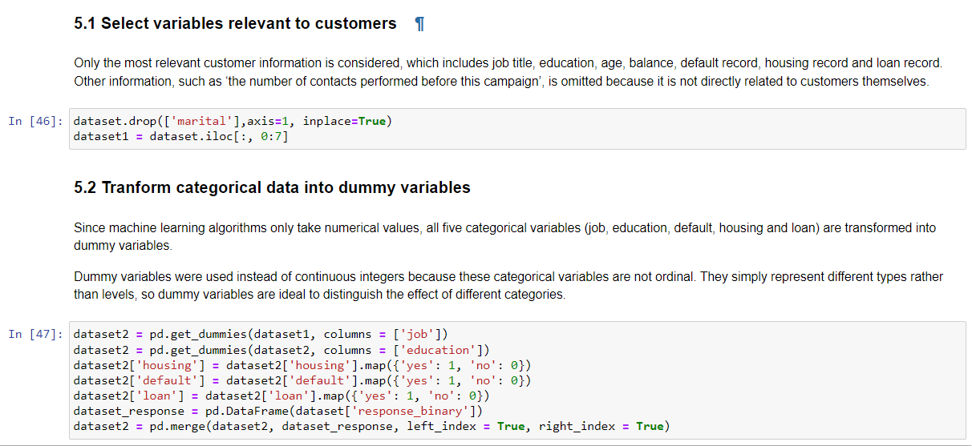
Prepare Data for Classification
34

Slide 35
Prepare Data for Classification
35

Slide 36
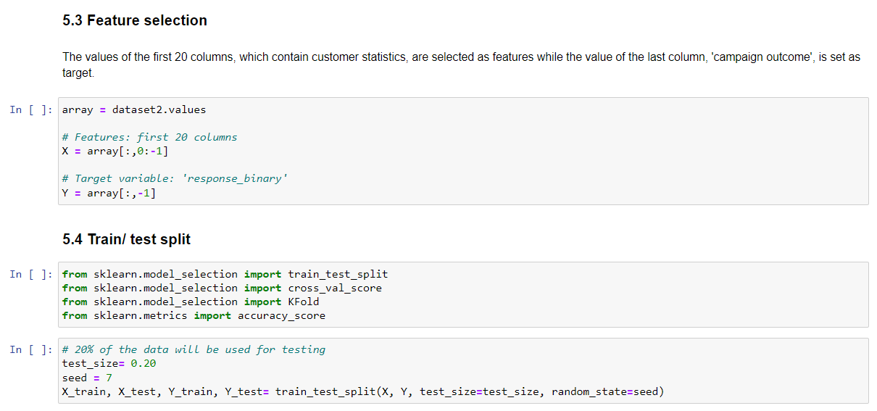
Prepare Data for Classification
36

Slide 37
Classification Algorithms
Logistic Regression
K-nearest neighbours
Decision Tree
Gaussian Naive Bayes
37

Slide 38
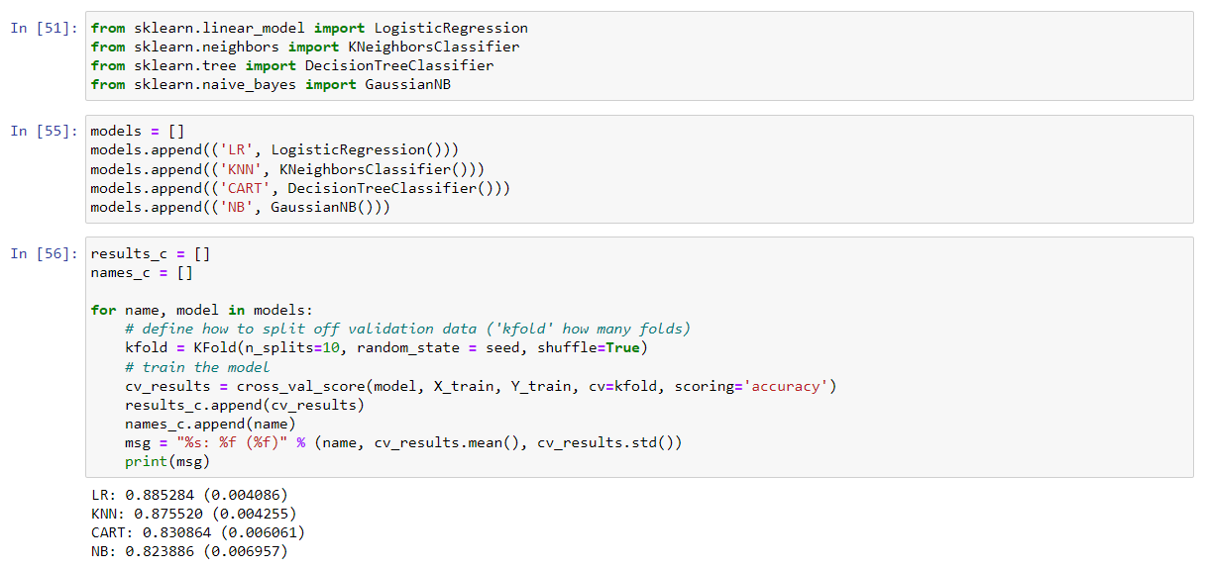
Compare Classification Algorithms
38

Slide 39
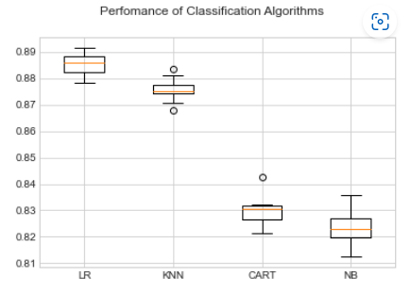
Compare classification algorithms
Logistic regression is the best performing model.
Among all algorithms, logistic regression achieved an accuracy of about 88%, suggesting a high level of strength of this model to classify the customer response given all the defined customer features.
39

Slide 40
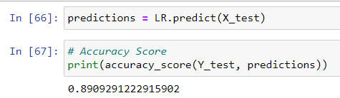
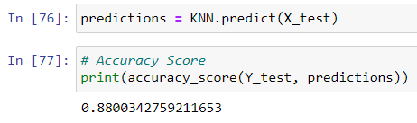
Evaluate LR & KNN Model – Accuracy Score
The LR algorithm achieves a higher accuracy of 89.08%, suggesting high level of strength of this model to classify the customer response given all the defined customer features.
40
Notes:
Accuracy score is the percentage of correct predictions out of all predictions made.

Slide 41
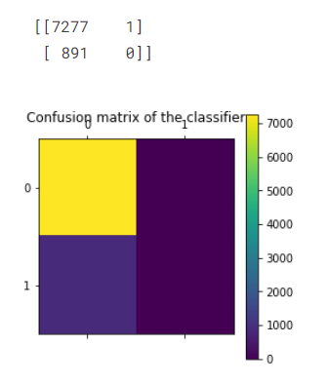

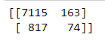
Evaluate LR & KNN Model – Confusion Matrix
41
Notes:
However, the result of accuracy score can possibly yield misleading result if the data set is unbalanced, because the number of observations in different classes largely vary.
A confusion matrix gives a detailed breakdown of prediction result and error types. Each cell in the matrix represents a combination of instances of the predicted response and the actual response. In the test set, the matrix proves that the algorithm performed well because most test results (7277 True Positive predictions) locate on the diagonal cells which represent correct predictions. 891 tests (False negative) predicted the bank’s client would subscribe to the term deposit but they actually did not.
A problem revealed by this confusion matrix is that the dataset is highly unbalanced, with nearly all client actually decline to subscribe. This infers that the accuracy score is biased, and further evaluation should be carried out to determine the accuracy of logistic regression model.

Slide 42
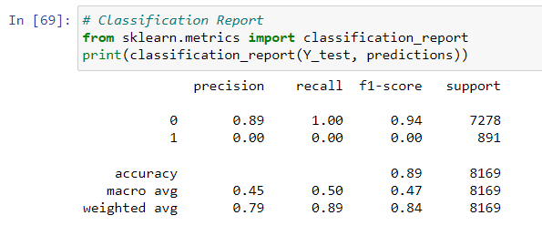
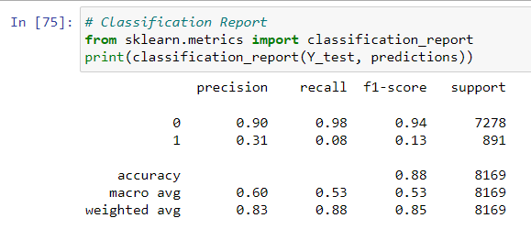
Evaluate LR Model – Classification Report
Precision of 0 (the client said no) represents that for all instances predicted as no subscription.
Recall is the ability of a classifier to find all positive instances. LR-Recall of 0 indicates that for all clients that said no, the model predicts 100% correctly that they would decline the offer. KNN – Recall of 8%, some client said yes.
42
Notes:
Classification report shows the precision, recall, F1 and support scores for the LR classification model.
In general, the report shows that LR model has great predictive power to identify the customers who would not subscribe to the term deposit. However, because of the limited number of clients accepting the term deposit, there is a need for stratified sampling or rebalancing to deal with this structural weakness before we conclude whether LR algorithm can accurately classify those who are more likely to subscribe.

Slide 43

Conclusion
The most responsive customers possess the following features:
Feature 1: Age < 30 or age > 60
Feature 2: Students or retired people
Feature 3: A balance of more than 5000 euros
The bank can allocate more marketing efforts to the above customers who are classified as highly likely to accept term deposits and call less to those who are unlikely to make term deposits.
43

Slide 44

Recommendations
1. Campaign Period
The previous analysis points out that March, September, October and December had the highest success rates. If the trend has the potential to continue in the future, the bank should consider initiating its telemarketing campaign in fall and spring.
2. Smarter Marketing Adjustment
By targeting the right customers, the bank will have more accurate information and positive responses, and this helps classification algorithms to eliminate the imbalance in the original dataset. In the meanwhile, to increase the likelihood of making a deposit, the bank could re-evaluate the content and design of its current campaign, to appeal its target customers.
44
Notes:
1. More appropriate timing
When implementing a marketing strategy, external factors, such as the time of calling, should also be carefully considered. The previous analysis points out that March, September, October and December had the highest success rates. Nevertheless, more data should be collected and analyzed to make sure that this seasonal effect is constant over time. If the trend has the potential to continue in the future, the bank should consider initiating its telemarketing campaign in fall and spring.
2. Smarter marketing design
By targeting the right customers, the bank will have more and more positive responses, and the classification algorithms would ultimately eliminate the imbalance in the original dataset. Hence, more accurate information will be presented to the bank for improving the subscriptions. Meanwhile, to increase the likelihood of subscription, the bank should re-evaluate the content and design of its current campaign, making it more appealing to its target customers.
3. Better services provision
With a more granular understanding of its customer base, the bank has the ability to provide better banking services. For example, marital status and occupation reveal a customer's life stage while loan status indicates his/her overall risk profile. With this information, the bank can estimate when a customer might need to make an investment. In this way, the bank can better satisfy its customer demand by providing banking services for the right customer at the right time.

Slide 45
Recommendations
3. Better services provision
For example, based on the dataset, marital status and occupation indicates a customer's life stage and loan status measures his/her overall risk assessment. These information can help the bank to predict when a customer is likely to make an investment. Thus, the bank can better satisfy its customer demand by providing relevant banking services for the right customer at the right time.
4. Limit the number of campaign calls per customer.
As seen in previous analysis, bank should resist calling a client for more than five times, which may increase dissatisfaction.
45
Notes:
1. More appropriate timing
When implementing a marketing strategy, external factors, such as the time of calling, should also be carefully considered. The previous analysis points out that March, September, October and December had the highest success rates. Nevertheless, more data should be collected and analyzed to make sure that this seasonal effect is constant over time. If the trend has the potential to continue in the future, the bank should consider initiating its telemarketing campaign in fall and spring.
2. Smarter marketing design
By targeting the right customers, the bank will have more and more positive responses, and the classification algorithms would ultimately eliminate the imbalance in the original dataset. Hence, more accurate information will be presented to the bank for improving the subscriptions. Meanwhile, to increase the likelihood of subscription, the bank should re-evaluate the content and design of its current campaign, making it more appealing to its target customers.
3. Better services provision
With a more granular understanding of its customer base, the bank has the ability to provide better banking services. For example, marital status and occupation reveal a customer's life stage while loan status indicates his/her overall risk profile. With this information, the bank can estimate when a customer might need to make an investment. In this way, the bank can better satisfy its customer demand by providing banking services for the right customer at the right time.

Slide 46




Thank you
Kimberly Tan

